Slide 1

CHAPTER 9
COUNTING AND
PROBABILITY
Copyright © Cengage Learning. All rights reserved.

Slide 2
SECTION 9.5
Counting Subsets of a Set: Combinations
Copyright © Cengage Learning. All rights reserved.

Slide 3
Counting Subsets of a Set: Combinations
Given a set S with n elements, how many subsets of size r can be chosen from S?
The number of subsets of size r that can be chosen from S
equals the number of subsets of size r that S has.
Each individual subset of size r is called an r-combination of the set.

Slide 4
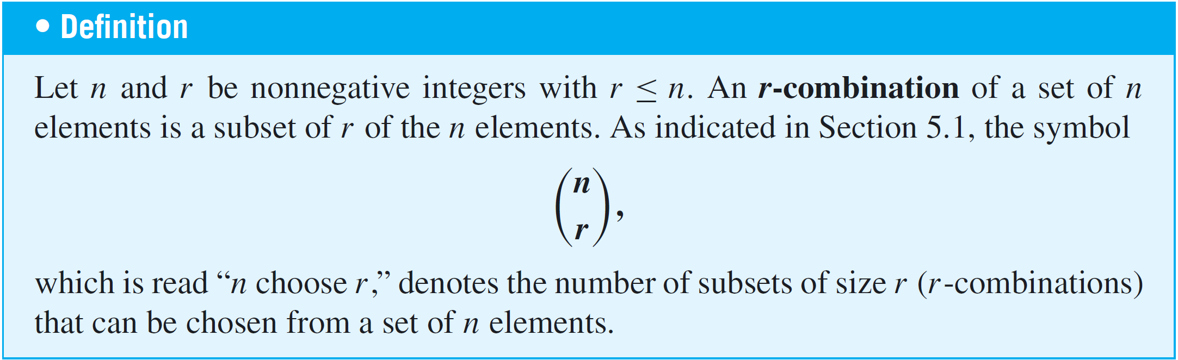

Counting Subsets of a Set: Combinations
We have known that calculators generally use symbols like C(n, r ), _{n}C_{r} , C_{n,r} , or ^{n}C_{r} instead of .

Slide 5


Example 1 – 3-Combinations
Let S = {Ann, Bob, Cyd, Dan}. Each committee consisting of three of the four people in S is a 3-combination of S.
a. List all such 3-combinations of S.
b. What is ?
Solution:
a. Each 3-combination of S is a subset of S of size 3. But
each subset of size 3 can be obtained by leaving out one
of the elements of S.
The 3-combinations are
{Bob, Cyd, Dan}

Slide 6




Example 1 – Solution
cont’d
{Ann, Cyd, Dan}
{Ann, Bob, Dan}
{Ann, Bob, Cyd}
b. Because is the number of 3-combinations of a set
with four elements, by part (a), = 4.

Slide 7
Counting Subsets of a Set: Combinations
There are two distinct methods that can be used to select r objects from a set of n elements. In an ordered selection, it is not only what elements are chosen but also the order in which they are chosen that matters.
Two ordered selections are said to be the same if the elements chosen are the same and also if the elements are chosen in the same order. An ordered selection of r elements from a set of n elements is an r-permutation of the set.

Slide 8
Counting Subsets of a Set: Combinations
In an unordered selection, on the other hand, it is only the identity of the chosen elements that matters. Two unordered selections are said to be the same if they consist of the same elements, regardless of the order in which the elements are chosen.
An unordered selection of r elements from a set of n elements is the same as a subset of size r or an
r-combination of the set.

Slide 9

Example 2 – Unordered Selections
How many unordered selections of two elements can be made from the set {0, 1, 2, 3}?
Solution:
An unordered selection of two elements from {0, 1, 2, 3} is the same as a 2-combination, or subset of size 2, taken from the set.
These can be listed systematically:
{0, 1}, {0, 2}, {0, 3}
{1, 2}, {1, 3}

Slide 10

Example 2 – Solution
cont’d
{2, 3}
Since this listing exhausts all possibilities, there are six subsets in all.
Thus = 6, which is the number of unordered selections of two elements from a set of four.

Slide 11

Counting Subsets of a Set: Combinations
When the values of n and r are small, it is reasonable to calculate values of using the method of complete enumeration (listing all possibilities) illustrated in
Examples 1 and 2. But when n and r are large, it is not feasible to compute these numbers by listing and counting all possibilities.
The general values of can be found by a somewhat indirect but simple method.
An equation is derived that contains as a factor. Then this equation is solved to obtain a formula for . The method is illustrated in the next Example.

Slide 12

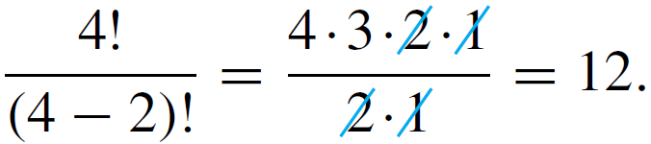
Example 3 – Relation between Permutations and Combinations
Write all 2-permutations of the set {0, 1, 2, 3}. Find an equation relating the number of 2-permutations, P(4, 2), and the number of 2-combinations, , and solve this equation for .
Solution:
According to Theorem 9.2.3, the number of 2-permutations of the set {0, 1, 2, 3} is P(4, 2), which equals

Slide 13
Example 3 – Solution
cont’d
Now the act of constructing a 2-permutation of {0, 1, 2, 3} can be thought of as a two-step process:
Step 1: Choose a subset of two elements from {0, 1, 2, 3}.
Step 2: Choose an ordering for the two-element subset.

Slide 14
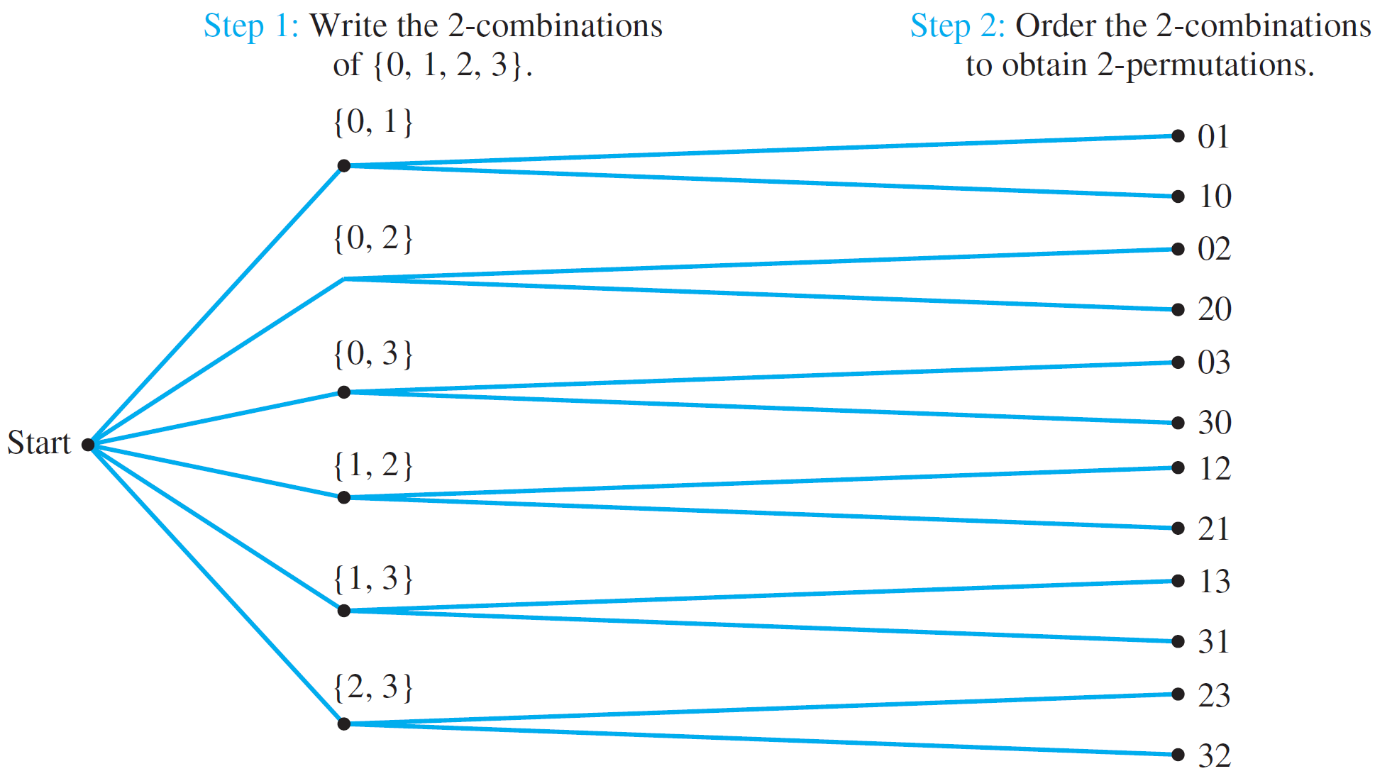
Example 3 – Solution
cont’d
This process can be illustrated by the possibility tree shown in Figure 9.5.1.
Relation between Permutations and Combinations
Figure 9.5.1

Slide 15

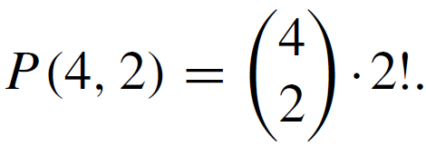

Example 3 – Solution
cont’d
The number of ways to perform step 1 is ,, the same as the number of subsets of size 2 that can be chosen from
{0, 1, 2, 3}.
The number of ways to perform step 2 is 2!, the number of ways to order the elements in a subset of size 2.
Because the number of ways of performing the whole process is the number of 2-permutations of the set
{0, 1, 2, 3}, which equals P(4, 2), it follows from the product rule that

Slide 16
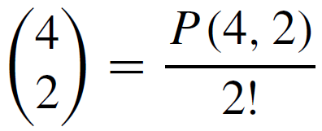
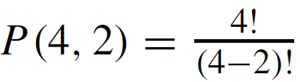
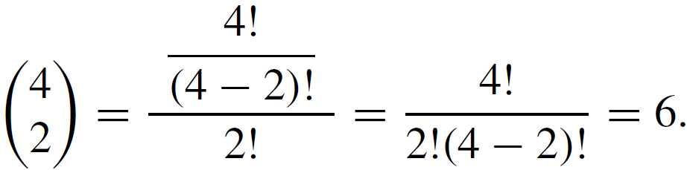
Example 3 – Solution
cont’d
Solving the equation for gives
We know that .
Hence, substituting yields

Slide 17
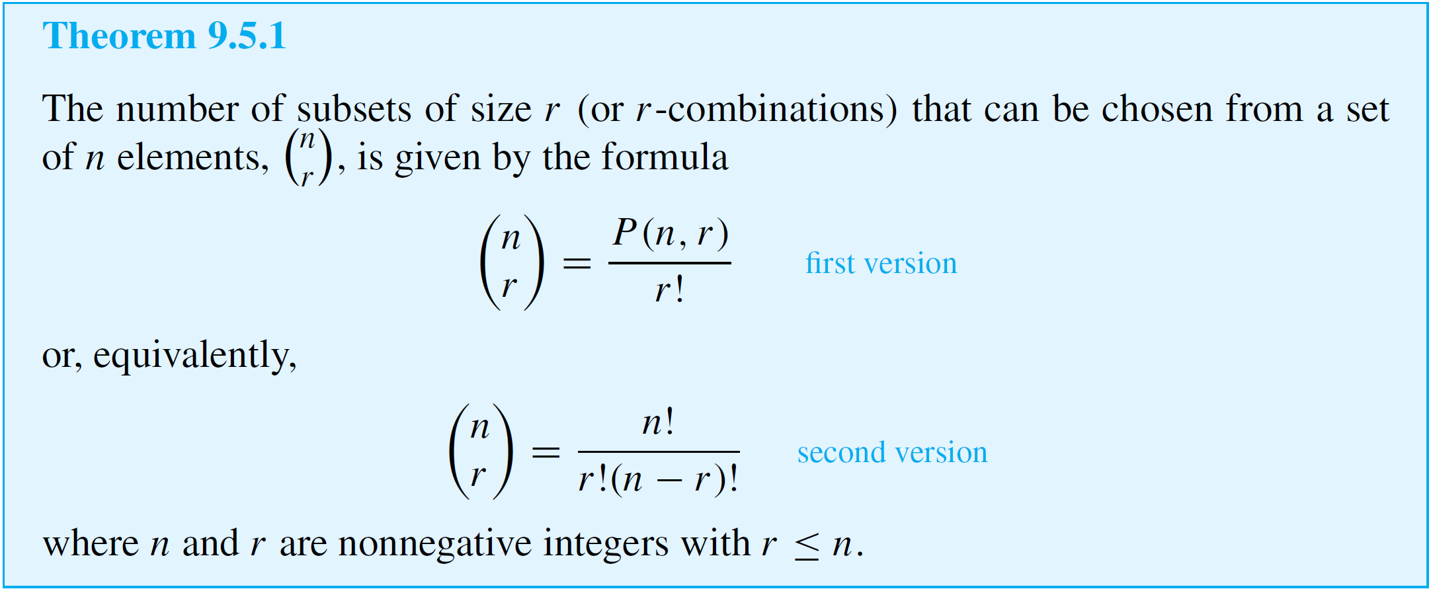
Counting Subsets of a Set: Combinations
The reasoning used in Example 3 applies in the general case as well.

Slide 18

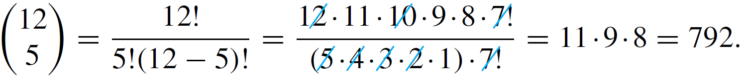
Example 4 – Calculating the Number of Teams
Consider again the problem of choosing five members from
a group of twelve to work as a team on a special project.
How many distinct five-person teams can be chosen?
Solution:
The number of distinct five-person teams is the same as the number of subsets of size 5 (or 5-combinations) that can be chosen from the set of twelve. This number is .
By Theorem 9.5.1,
Thus there are 792 distinct five-person teams.

Slide 19
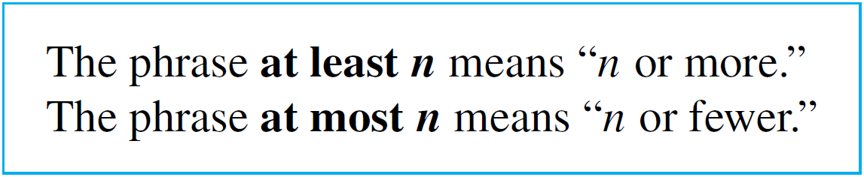
Counting Subsets of a Set: Combinations
The formula for the number of r-combinations of a set can be applied in a wide variety of situations. Let us illustrate this in the next example.
Before we begin the next example, a remark on the phrases at least and at most is in order:
For instance, if a set consists of three elements and you are to choose at least two, you will choose two or three; if you are to choose at most two, you will choose none, or one, or two.

Slide 20
Example 7 – Teams with Members of Two Types
Suppose the group of twelve consists of five men and seven women.
a. How many five-person teams can be chosen that consist
of three men and two women?
b. How many five-person teams contain at least one man?
c. How many five-person teams contain at most one man?
Solution:
a. To answer this question, think of forming a team as a
two-step process:
Step 1: Choose the men.

Slide 21


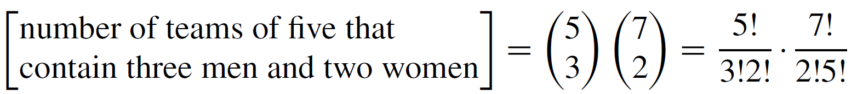
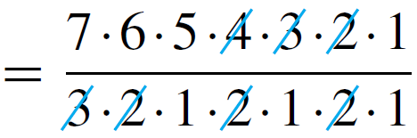

Example 7 – Solution
cont’d
Step 2: Choose the women.
There are ways to choose the three men out of the five and ways to choose the two women out of the seven.
Hence, by the product rule,

Slide 22
Example 7 – Solution
cont’d
b. This question can also be answered either by the
addition rule or by the difference rule. The solution by the
difference rule is shorter and is shown first.
Observe that the set of five-person teams containing at
least one man equals the set difference between the set
of all five-person teams and the set of five-person teams
that do not contain any men.

Slide 23
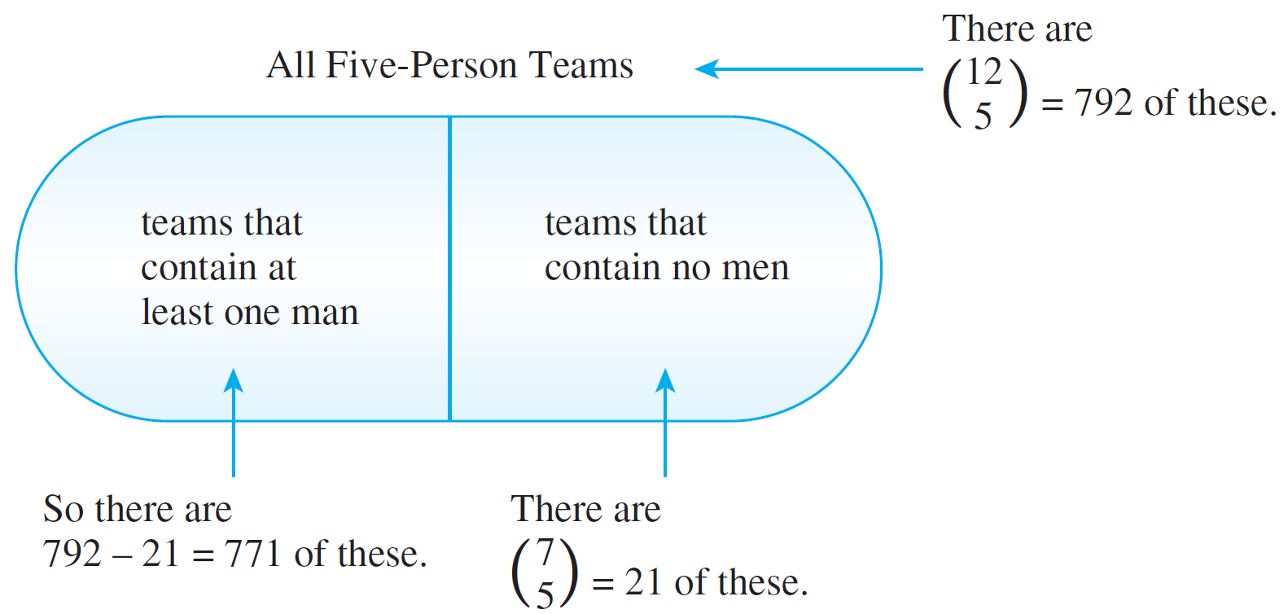
Example 7 – Solution
cont’d
See Figure 9.5.5.
Figure 9.5.5

Slide 24


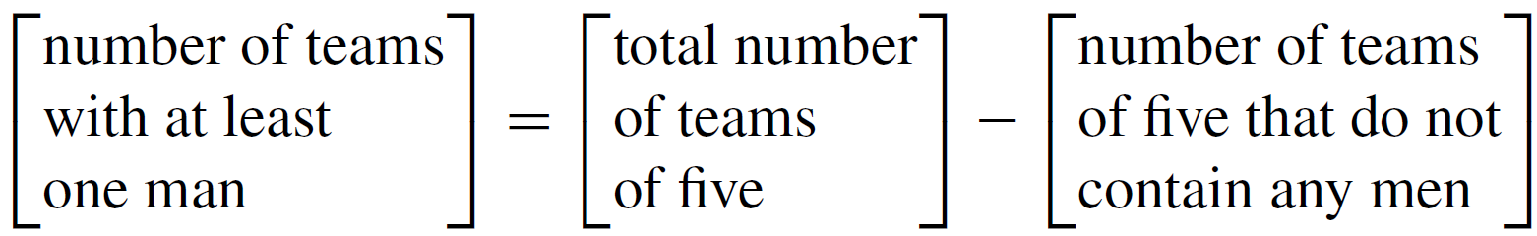
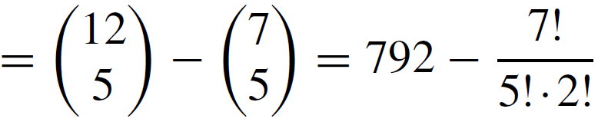
Example 7 – Solution
cont’d
Now a team with no men consists entirely of five women chosen from the seven women in the group, so there are such teams. Also, by Example 4, the total number of
five-person teams is = 792.
Hence, by the difference rule,

Slide 25
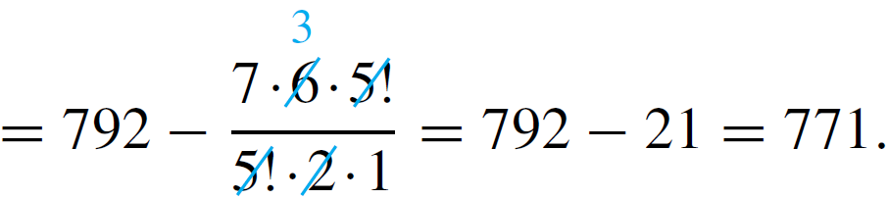
Example 7 – Solution
cont’d
This reasoning is summarized in Figure 9.5.5.
Figure 9.5.5

Slide 26
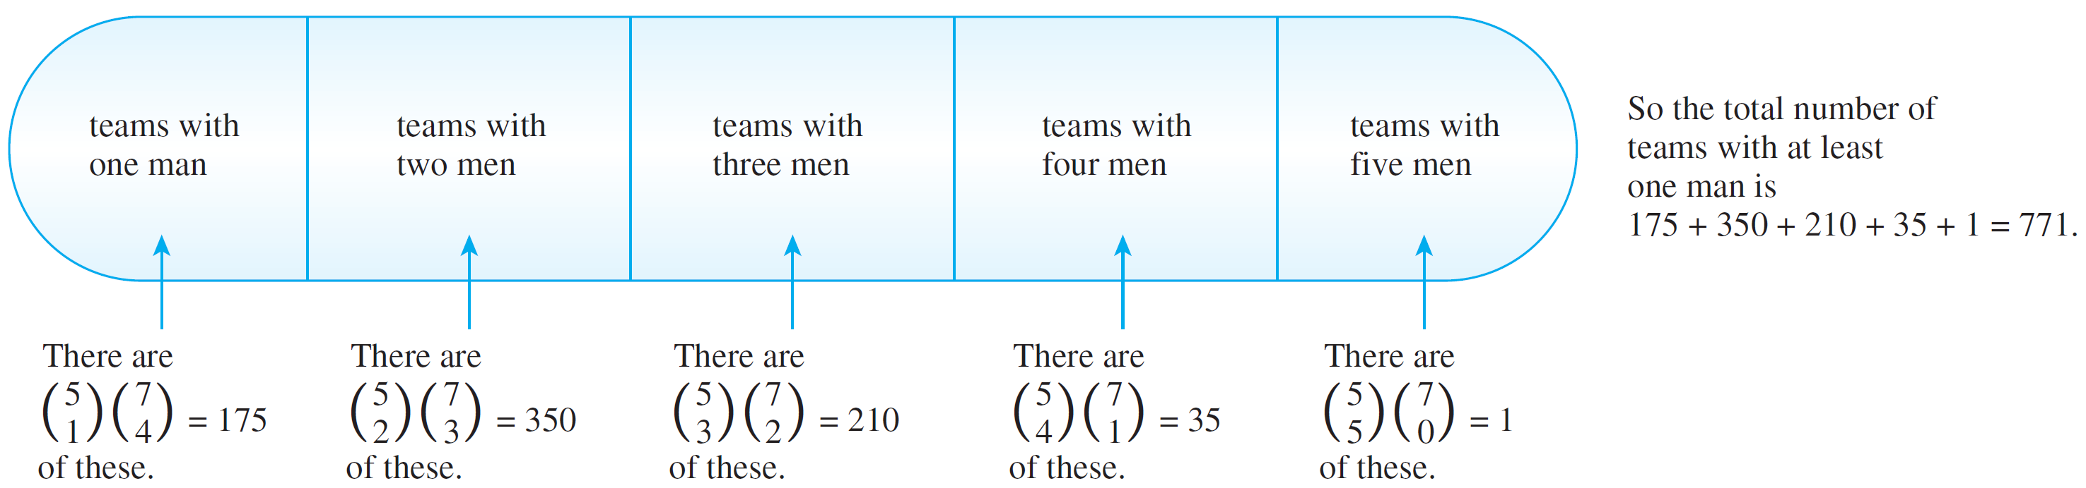
Example 7 – Solution
cont’d
Alternatively, to use the addition rule, observe that the set of teams containing at least one man can be partitioned as shown in Figure 9.5.6.
Teams with At Least One Man
Figure 9.5.6

Slide 27
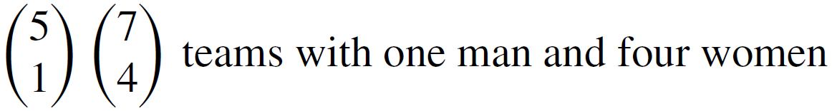
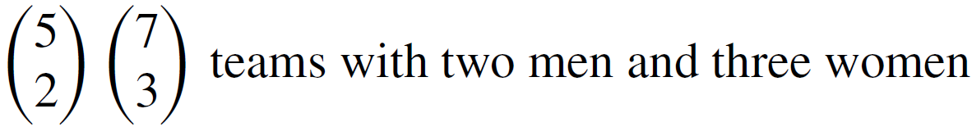
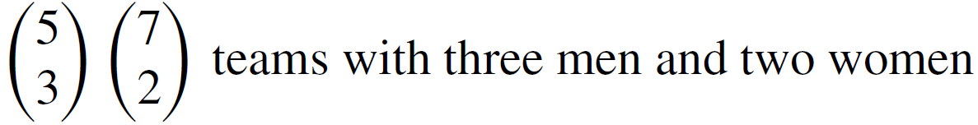
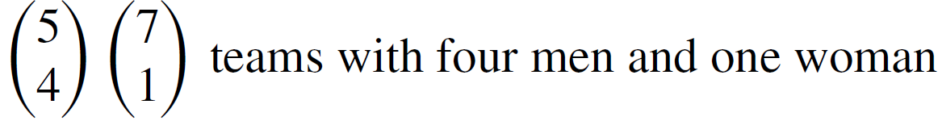
Example 7 – Solution
cont’d
The number of teams in each subset of the partition is calculated using the method illustrated in part (a). There are

Slide 28
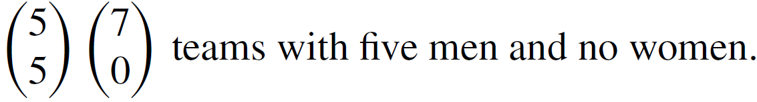
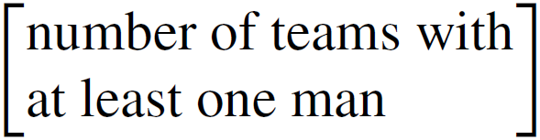
Example 7 – Solution
cont’d
Hence, by the addition rule,

Slide 29
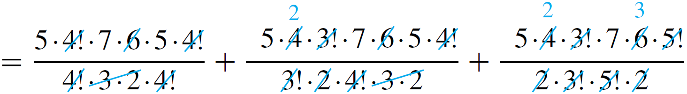
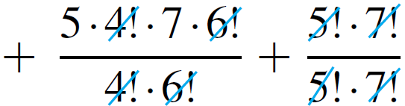
Example 7 – Solution
cont’d

Slide 30
Example 7 – Solution
cont’d
This reasoning is summarized in Figure 9.5.6.
Teams with At Least One Man
Figure 9.5.6

Slide 31
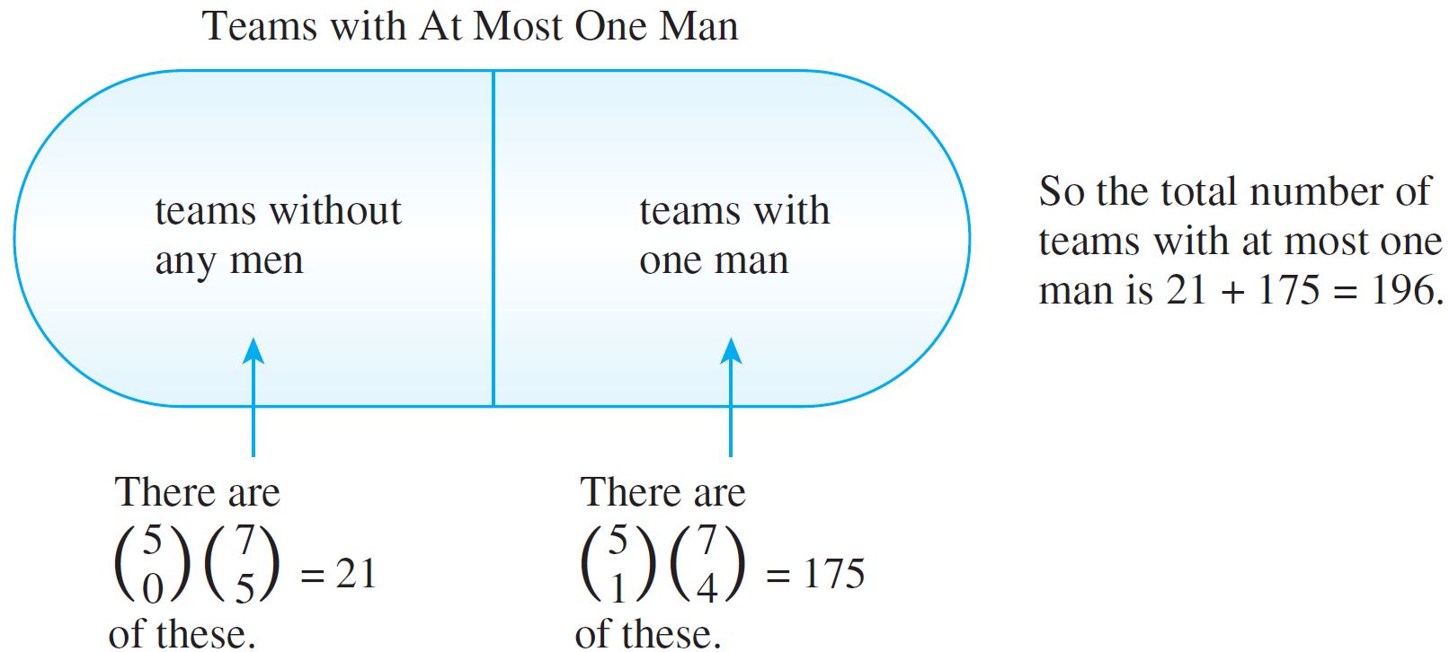
Example 7 – Solution
cont’d
c. As shown in Figure 9.5.7, the set of teams containing at
most one man can be partitioned into the set that does
not contain any men and the set that contains exactly
one man.
Hence, by the addition rule,
Teams with At Most One Man
Figure 9.5.7

Slide 32
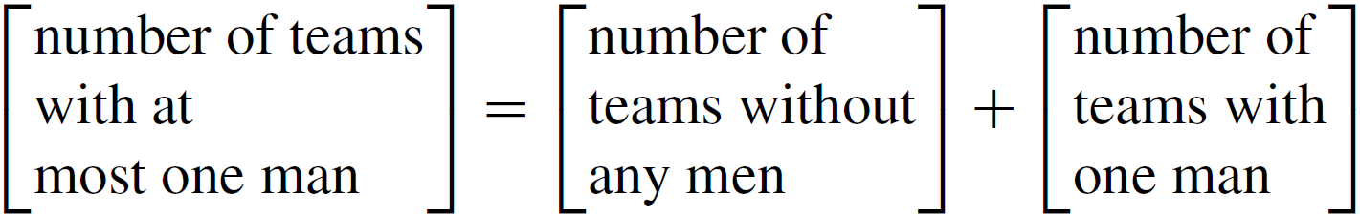
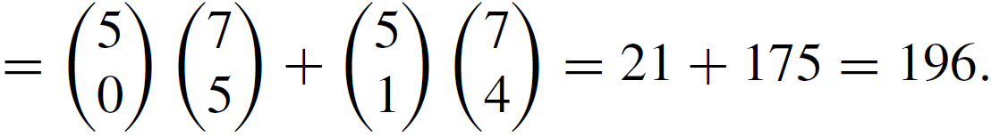
Example 7 – Solution
cont’d
This reasoning is summarized in Figure 9.5.7.

Slide 33
Example 10 – Permutations of a Set with Repeated Elements
Consider various ways of ordering the letters in the word MISSISSIPPI:
IIMSSPISSIP, ISSSPMIIPIS, PIMISSSSIIP, and so on.
How many distinguishable orderings are there?

Slide 34
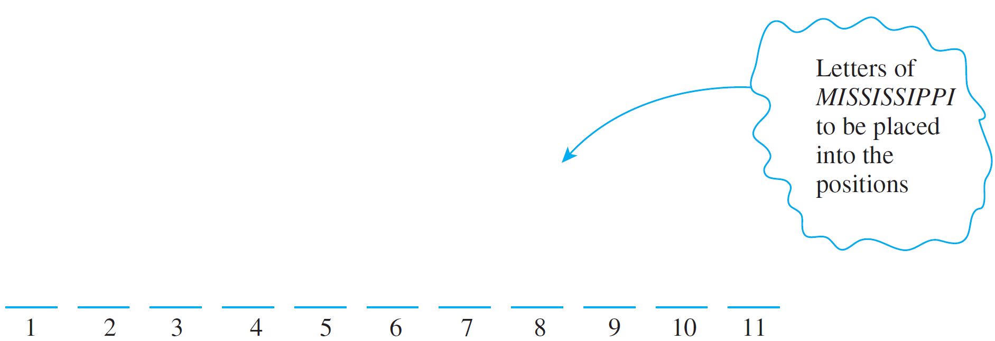
Example 10 – Solution
Imagine placing the 11 letters of MISSISSIPPI one after another into 11 positions.
Because copies of the same letter cannot be distinguished from one another, once the positions for a certain letter are known, then all copies of the letter can go into the positions in any order.

Slide 35

Example 10 – Solution
cont’d
It follows that constructing an ordering for the letters can be thought of as a four-step process:
Step 1: Choose a subset of four positions for the S’s.
Step 2: Choose a subset of four positions for the I’s.
Step 3: Choose a subset of two positions for the P’s.
Step 4: Choose a subset of one position for the M.
Since there are 11 positions in all, there are subsets of four positions for the S’s.

Slide 36



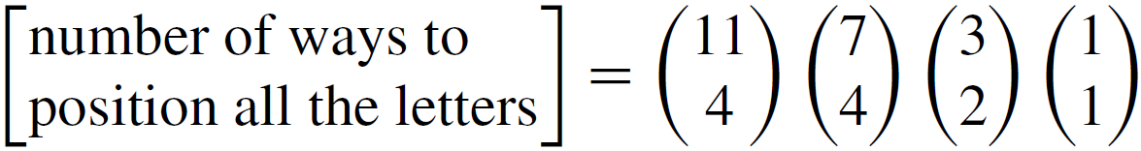
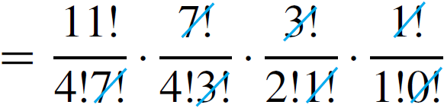
Example 10 – Solution
cont’d
Once the four S’s are in place, there are seven positions that remain empty, so there are subsets of four positions for the I’s. After the I’s are in place, there are three positions left empty, so there are subsets of two positions for the P’s.
That leaves just one position for the M. But 1 = . Hence by the multiplication rule,

Slide 37
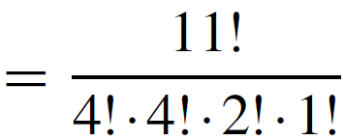

Example 10 – Solution
cont’d

Slide 38
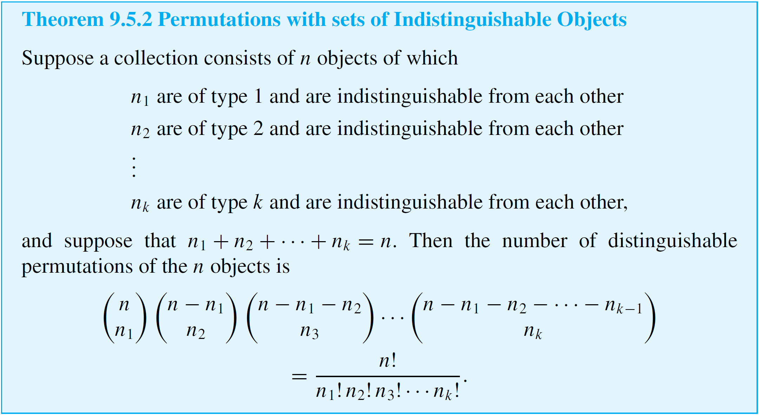
Counting Subsets of a Set: Combinations
The reasoning used in this example can be used to derive the following general theorem.

Slide 39
Some Advice about Counting

Slide 40
Some Advice about Counting
Students learning counting techniques often ask, “How do I know what to multiply and what to add? When do I use the multiplication rule and when do I use the addition rule?” Unfortunately, these questions have no easy answers.
You should construct a model that would allow you to continue counting the objects one by one if you had enough time.
If you can imagine the elements to be counted as being obtained through a multistep process then you can use the multiplication rule.

Slide 41
Some Advice about Counting
The total number of elements will be the product of the number of ways to perform each step. If, however, you can imagine the set of elements to be counted as being broken up into disjoint subsets, then you can use the addition rule.
The total number of elements in the set will be the sum of the number of elements in each subset.
One of the most common mistakes students make is to count certain possibilities more than once.

Slide 42
Example 11 – Double Counting
Consider again the problem of Example 7(b). A group consists of five men and seven women. How many teams of five contain at least one man?
Incorrect Solution
Imagine constructing the team as a two-step process:
Step 1: Choose a subset of one man from the five men.
Step 2: Choose a subset of four others from the remaining
eleven people.

Slide 43


Example 11 – Double Counting
cont’d
Hence, by the multiplication rule, there are  = 1,650 five-person teams that contain at least one man.
Analysis of the Incorrect Solution
The problem with the solution is that some teams are counted more than once. Suppose the men are Anwar, Ben, Carlos, Dwayne, and Ed and the women are Fumiko, Gail, Hui-Fan, Inez, Jill, Kim, and Laura.
According to the method described previously, one possible outcome of the two-step process is as follows:
Outcome of step 1: Anwar
Outcome of step 2: Ben, Gail, Inez, and Jill.

Slide 44
Example 11 – Solution
cont’d
In this case the team would be {Anwar, Ben, Gail, Inez, Jill}. But another possible outcome is
Outcome of step 1: Ben
Outcome of step 2: Anwar, Gail, Inez, and Jill,
which also gives the team {Anwar, Ben, Gail, Inez, Jill}.
Thus this one team is given by two different branches of the possibility tree, and so it is counted twice.

Slide 45
The Number of Partitions of a
Set into r Subsets

Slide 46

The Number of Partitions of a Set into r Subsets
In an ordinary (or singly indexed) sequence, integers n are associated to numbers a_{n}. In a doubly indexed sequence, ordered pairs of integers (m, n) are associated to numbers a_{m,n}.
For example, combinations can be thought of as terms of the doubly indexed sequence defined by C_{n,r} = for all integers n and r with 0 ≤ r ≤ n.
An important example of a doubly indexed sequence is the sequence of Stirling numbers of the second kind.

Slide 47
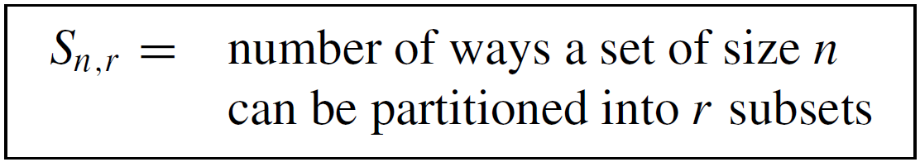
The Number of Partitions of a Set into r Subsets
Observe that if a set of three elements {x₁, x₂, x₃} is partitioned into two subsets, then one of the subsets has one element and the other has two elements. Therefore, there are three ways the set can be partitioned:
{x₁, x₂}{x₃} put x₃ by itself
{x₁, x₃}{x₂} put x₂ by itself
{x₂, x₃}{x₁} put x₁ by itself
In general, let

Slide 48
The Number of Partitions of a Set into r Subsets
Then, by the above, S_{3.2} = 3. The numbers S_{n,r} are called Stirling numbers of the second kind.

Slide 49
Example 12 – Values of Stirling Numbers
Find S_{4,1}, S_{4,2}, S_{4,3}, and S_{4,4}.
Solution:
Given a set with four elements, denote it by {x₁, x₂, x₃, x₄}. The Stirling number S_{4,1} = 1 because a set of four elements can be partitioned into one subset in only one way:
{x₁, x₂, x₃, x₄}.
Similarly, S_{4,4} = 1 because there is only one way to partition a set of four elements into four subsets:
{x₁}{x₂}{x₃}{x₄}.

Slide 50
Example 12 – Solution
cont’d
The number S_{4,2} = 7. The reason is that any partition of
{x₁, x₂, x₃, x₄} into two subsets must consist either of two subsets of size two or of one subset of size three and one subset of size one.
The partitions for which both subsets have size two must pair x₁ with x₂, with x₃, or with x₄, which give rise to these three partitions:
{x₁, x₂}{x₃, x₄} x₂ paired with x₁
{x₁, x₃}{x₂, x₄} x₃ paired with x₁
{x₁, x₄}{x₂, x₃} x₄ paired with x₁

Slide 51
Example 12 – Solution
cont’d
The partitions for which one subset has size one and the other has size three can have any one of the four elements in the subset of size one, which leads to these four partitions:
{x₁}{x₂, x₃, x₄} x₁ by itself
{x₂}{x₁, x₃, x₄} x₂ by itself
{x₃}{x₁, x₂, x₄} x₃ by itself
{x₄}{x₁, x₂, x₃} x₄ by itself
It follows that the total number of ways that the set
{x₁, x₂, x₃, x₄} can be partitioned into two subsets is
3 + 4 = 7.

Slide 52

Example 12 – Solution
cont’d
Finally, S_{4,3} = 6 because any partition of a set of four elements into three subsets must have two elements in one subset and the other two elements in subsets by themselves.
There are = 6 ways to choose the two elements to put together, which results in the following six possible partitions:
{x₁, x₂}{x₃}{x₄} {x₂, x₃}{x₁}{x₄}
{x₁, x₃}{x₂}{x₄} {x₂, x₄}{x₁}{x₃}
{x₁, x₄}{x₂}{x₃} {x₃, x₄}{x₁}{x₂}

